Slide 1
V for Vendetta

Slide 3
"Beneath this mask there is more than flesh... Beneath this mask there is an idea, Mr. Creedy, and ideas are bulletproof."

Slide 4
Overview
V for Vendetta deals with issues of race, sexuality, religion, totalitarianism, and terrorism. Its controversial story line and themes have, inevitably, made it the target of both criticism and praise from sociopolitical groups.
It shows us a dystopian world where political power is above individual freedoms and people are oppressed in the name of unity.

Slide 5
‘People should not be afraid of their governments. Governments should be afraid of their people.’
V is a man who wears a mask, he is an enigma. His mission is to overthrow an unjust society, by any means possible.
Evey is a young girl who is frightened – she should be…..

Slide 6
Main characters- Evey
Evey is a young girl whose parents were imprisoned
She fears standing out
She is ambitious
She wants to be an actress
She has few friends
She works for BTN

Slide 7
Main characters - V
V is the man in the mask
He alliterates everything with V
He is passionate about art, literature and music
Pop culture and high culture
He believes in freedom

Slide 8
Main characters- Chancellor Sutler
High Chancellor of England
Gained power in a coup
Dirty politics behind his rise
Linked to Three Waters and St Mary’s deaths
Has large secret service and control of everything

Slide 9
Main characters – Mr. Creedy
Head of secret police called ‘fingermen’
Ambitious and ruthless
Known for his black bags
“ a man seemingly without a conscience, for whom the end always justifies the means” - V

Slide 10
Chief Inspector of Norsefire – the party that rules England
Asked by chancellor Sutler to track down V
Fair but pragmatic
Lonely
Begins to uncover unpalatable truths
Believes in justice

Slide 11
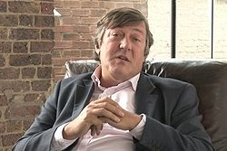
Gordon Deitrich
Evey’s boss
Older man
Clever, but lonely
Invites young girls to his house regularly – not because he wants to because he has to

Slide 12
Key Themes
Power and control can be used and abused.
The examination of political freedom
Totalitarianism can affect society.
Free speech versus censorship
Art and literature’s power to lift the human spirit
How justice and revenge are interpreted and disseminated by different sectors/characters

Slide 13
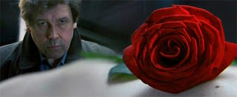
Symbolism in the film
Dominoes
Roses
Fireworks/Explosions
V (anarchy, 5, Villain or Victim?)
Masks
Propaganda
How are symbols used throughout the film and how do they convey the film-maker's message?

