Slide 1
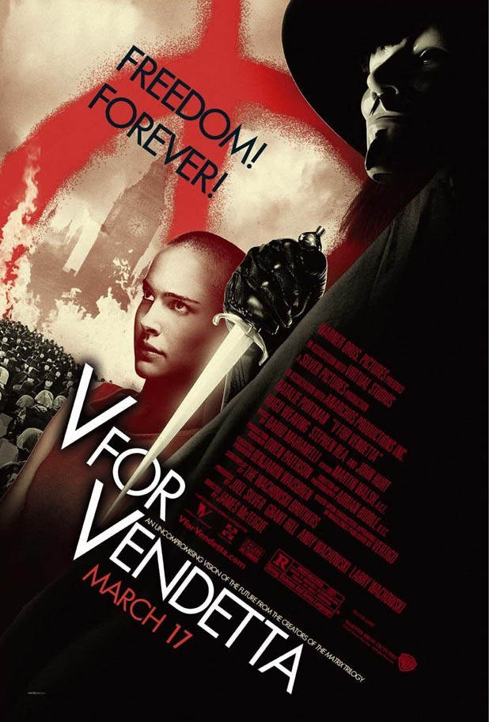
V for Vendetta
World Literature
Dystopian Film & Literature
Mr. Mahoney
Notes:
Film Clips: Clear and Present Danger excerpts

Slide 2
Background
Guy Fawkes tried to blow up Parliament on Nov 5, 1605 (Gunpowder Treason)
Government protestor acting alone (like V)
Both believed that destroying a symbol of power would change the nation’s political direction

Slide 3
Story Driven by how characters change
Evey
Finch
V
Do other characters also become Guy Fawkes reincarnated? Why?
What are their goals and achievements?

Slide 4
Music
Early on we hear Tchaiskowsky’s 1812 Overture with Explosions, when else do we hear this? Does it have the same effect
Consider the interplay between music and events in the following combinations:
Julie London sings “Cry Me A River” when V and Evey have their first conversation.
Stan Getz plays sax when V cooks Evey breakfast in the Shadow Gallery and also when Gordon Deitrich cooks Evey the same breakfast in his home.
Just before V shows Evey the explosive-laden subway train, the jukebox plays “Take the Long Black Train.”
How does music help set the mood for various scenes?

Slide 5
Role of the Media
Note how various media are used to move the story line forward:
TV news reports, some created as the story progresses, some as archival research.
TV shows as a means of diversion
Multiple televisions dominating everyone’s attention
Public music on the speakers in the London streets.
Lewis Prothero’s TV commentaries.
Newspaper headlines and archives.
Computer archives.
Tax records.
Surveillance camera images.
Gordon Deitrich’s TV show.

Slide 6
Constitutionalism
Constitutionalism is the idea that governments should be limited and that these limits are necessary for democracy
Constitutions are important because they codify the most basic laws of society
Constitutions place limits on power and establishes rights for the ruled
Why not just have laws that would do the same thing?
That would require government to be constantly self-limiting
Constitutions are harder to change and thus provide more security
i.e. Clear and Present Danger

Slide 7
War on Terror in V
Terrorist threat and motives are ambiguous
Do the terrorists exist?
Whether or not exist, creates a sense of fear
How must government respond
With force and promises of security from fear
“Need to avoid doubt and chaos” so that “England prevails”

Slide 8
How does the Government try to maintain power?
Appeals to patriotism: “Strength though Unity, Unity through Faith”
“Articles of Allegiance”
What is faith?
Surveillance (random audio sweeps)
Censorship
Threat of physical violence, black bags, re-education camps
What role do the people play?
Religion? Is the Church and Jesus vindicated?
Similarities to the Cuckoo’s Nest?

Slide 9
Resistance
Hero resorts to violence pretty quickly
Do the filmmakers deal with the issue of the death of innocent civilians?
Are other options discussed?
Is the conclusion appealing?
Is it likely?

Slide 10
Discussion Questions
V tells Evey that people shouldn't be afraid of their governments, but rather that governments should be afraid of their people. Do you agree? Why or why not?
The totalitarian Britain depicted in the film clearly needs reform. Is violence a necessary tool for instigating change in such a society? What's the difference between a terrorist and a revolutionary?
Can we differentiate between situations justifying the use of violence and those where non-violent civil disobedience such as that advocated by Thoreau or MLK would be more effective?

Slide 11
Discussion Questions
Is V's quest for justice justified by any means? Why or why not? What are some alternative plans he could have enacted?
The film discusses how ideas can’t be killed with force. Do you agree?
What does this say about the general thrust of the U.S.’s efforts to fight the war on terror?
Do you agree with the political suppositions of the film? Are our democratic societies on the path to oppression and totalitarianism?

Slide 12
Civil Liberties
List the freedoms you enjoy both in your home and your community
List the limitations we have on our freedom
Can you understand the reason for these limitations?
Civil Liberties are Constitutional provisions, laws, and practices that protect individuals from certain types of government interference
Where are they primarily found in the U.S.?
Primarily in the Constitution, particularly the Bill of Rights and the 14th amendment
Do people in other countries have these protections?
Why or why not?
Failure or success of Constitutionalism

Slide 13
What restrictions do we have on our privacy in the U.S.?
FBI surveillance
Corporations collecting data on consumers
Internet privacy issues
Drug testing at the workplace or school
Employers monitoring employees’ e-mails, phone calls, or bathroom usage
Limitations at home or in school

Slide 14
War on Terror
In any time of war, it may be necessary to suspend some freedoms
Following the attacks of 9/11/01, the government sought and received greater powers to combat terrorism
Patriot Act allows government access to
213: search home without informing you
215: collect information about what books you read, what you study, your purchases, and your medical history without probably cause
216: read parts of your email and monitor what you look at online without probably cause

Slide 15
Protections
How does the government justify limiting our freedoms?
These limitations are necessary to combat terrorism
A war on terrorism is an unconventional war where the enemies don’t wear uniforms and attack civilians
This is true, but how do we know the government won’t make mistakes?
How do we know our civil liberties won’t be abridged capriciously?
How do we know the rules will be followed especially toward those who are critical of those in power?
Can we or should we trust the government to do what is right?
What about the role of critical thought?
How are these questions are addressed in the films we’ve seen this semester?

Slide 16
Thoreau
According to Thoreau, what enables the few to use the government to their own ends?
What makes it possible is that people think they need the complicated machinery of government and crave the order it provides so they ignore their conscience and sense of justice, eschew critical thought, and just follow along
Simply that people do nothing

Slide 17
War on Terrorism
Describe any similarities between the war on terrorism in V and the contemporary war on terrorism in the U.S.
Is it possible that our government could come to resemble the type of government portrayed in V? Why or why not?
What role must the people play?

