Slide 1
Gender Study: Feminism in Film
Mr. Mahoney
Film and Literature
Course Elective

Slide 2
Feminist Film Theory
Women and Film magazine (1972) first posed the question of why women characters in feature films consistently occupied the recurrent, stereotypical roles of virgin, wife, mother and seductress.
The magazine opened the door to a rigorous reexamination of whether the glamour and pizzazz of beautiful stars giving powerful performances, predominantly in stereotypic roles, rightfully defined limits of female representation.

Slide 3
Stereotype – The Virgin
The virgin represents a male projection onto women of profound innocence and vulnerability. Men can then play the role of strong, resourceful protector.
Robin Wright in “The Princess Bride”

Slide 4
Stereotype – The Dumb Blonde
Innocence can also correspond to the image of a woman who may not actually be a virgin but whose innocence combines with obliviousness regarding her erotic effect on others.
Marilyn Monroe as “the girl”
in “The Seven Year Itch”

Slide 5
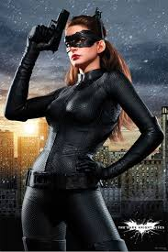
Stereotype – The Good Bad Girl
“The femme fatal anti-hero/ anti-villain. Her character traits do not denote what side of the moral line she is on because she is a little bit of both good and evil. In doing this, the moral line begins to disappear. Seductive, independent, and rebellious, we never know what these women will say or do next.” (2)
Anne Hathaway as The Cat Woman
in “The Dark Knight Rises”

Slide 6
Stereotype – The Good Bad Girl
“She is independent. She is armed with quick wit and fighting skills. While maneuvering men with their cheeky wiles, their beguiled quarries never seem to mind being deceived or manipulated. She is liberated but trapped: capable but empty.” (2)
Jennifer Lawrence as Katniss Everdeen
In “The Hunger Games”

Slide 7
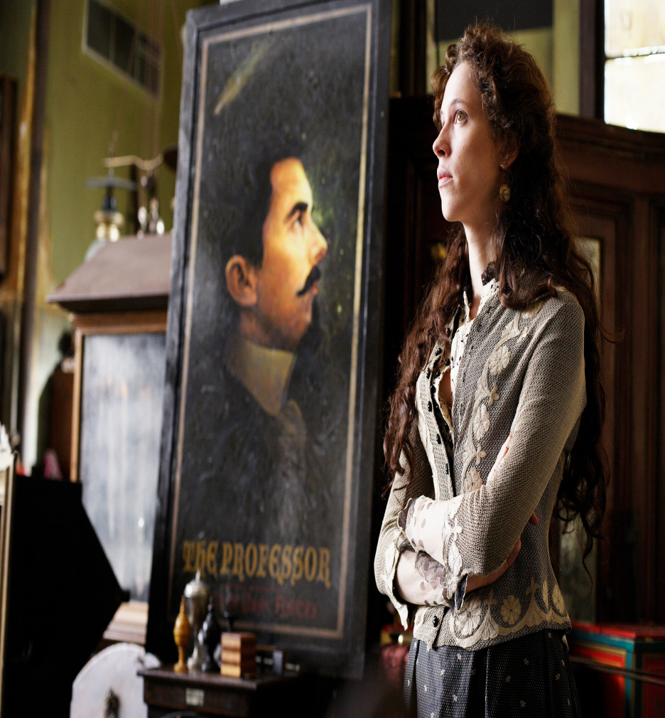
Stereotype – The Wife
“As a stereotype the wife takes up a
Subordinate position as support or
Impediment to her husband. She
remains strongly associated with
domestic space and family life. She keeps
the home fires burning as her husband
does battle in the public sphere, or her
complaints and worries weaken his
resolve to act boldly as a public figure,
something he must overcome by
showing her how society requires his
contribution to the greater good.” (1)
Rebecca Hall as Sara Borden
In “The Prestige”

Slide 8
Stereotype – The Mother
“As a stereotype the vital role of mother turns into the be-all and end-all of a woman’s life. Qualities that threaten the autonomy of men – nurturing, caring, intimacy – get projected onto the mother who will do anything for the good of her children and nothing to compromise her single-minded devotion to family.” (1)
Sandra Bullock as Leigh Anne Tuohy
in “The Blind Side”

Slide 9
Stereotype – The Mother
The mother stereotype exaggerates nurturing, sacrificial qualities above all. In this light, it is not uncommon for the mother to be represented as a compassionate figure, giving men the support they need.
Sally Field as Mrs. Gump in “Forest Gump”

Slide 10
Romantic Love: Passion vs. Marriage
“Romantic love protests against arranged marriages that secure fortunes but deny happiness. Its emphasis on courtship and the emotional state of being in love also protests against the all too easy pleasures of the flesh that offer fleeting gratification.”
“In this tradition, passion stimulates being in love; this state thrives on being thwrted, blocked, suspended, delayed, and deferred.”

