Slide 1
HENRY DAVID THOREAU and WALDEN POND
An exploration of the pond in Concord, MA where the Transcendentalist author lived and recorded his thoughts.

Slide 2
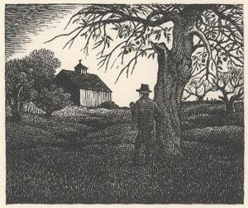
The Hollowell Farm

Slide 3
The Hollowell Farm
Thoreau uses the Hollowell Farm to showcase his belief that purchasing property actually “burns” the new owner. He suggests that one should liberate oneself from the desire to own something because it is better to leave it (land, nature, farms, and the landscape) alone or in a natural state. The minute one owns something, including a farm or land, it decreases in value.

Slide 4
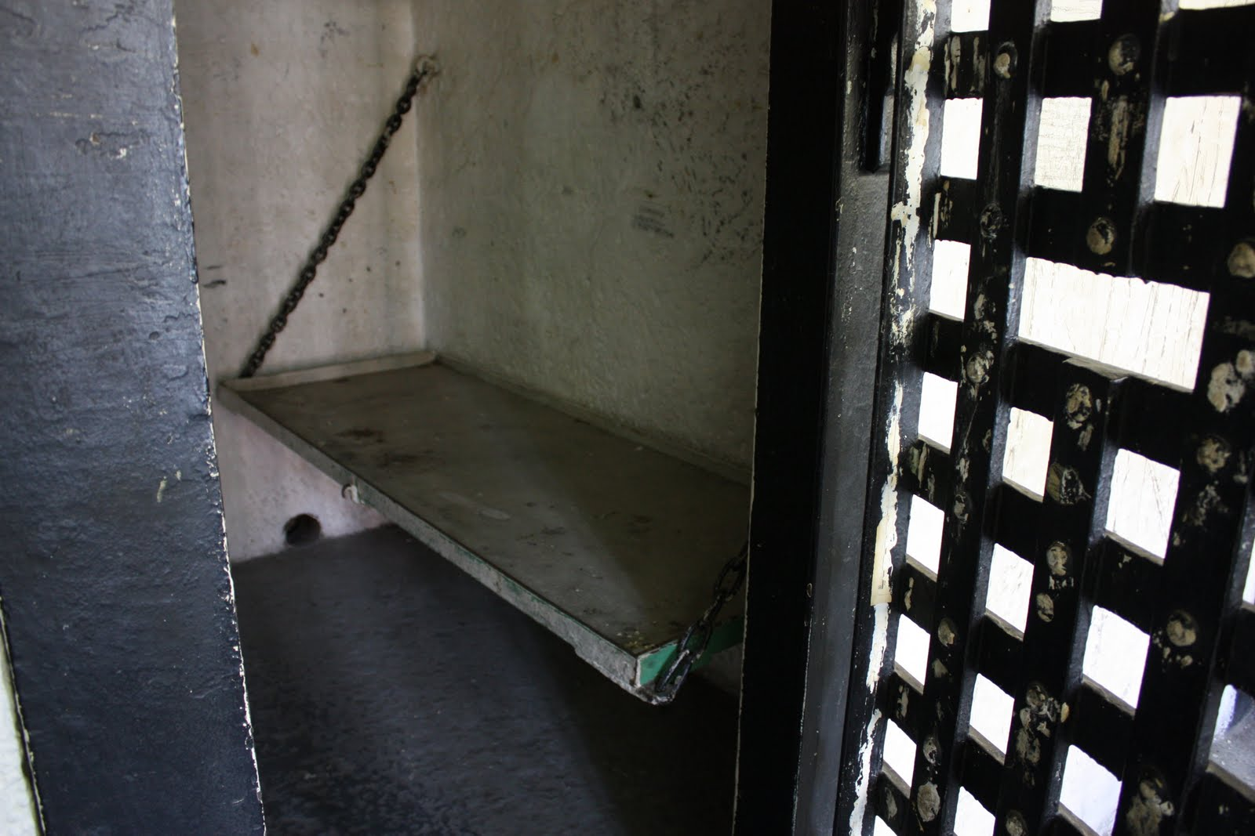
The county jail

Slide 5
The County Jail
The concept of the county jail comes in connection to the same premise established by Thoreau’s musings on the Hollowell Farm. Owning land, a house, or anything else requires commitment and these commitments steal precious minutes and hours of one’s life. One should seek to remain uncommitted and free for as longs as possible.

Slide 6
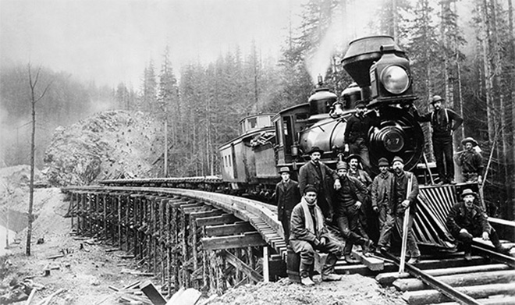
The Railroad

Slide 7
The Railroad
Thoreau uses the railroad to represent a few concepts. One is that so much time is invested in building the railroad so that people can move faster, quickly get to destinations, and then move on to the next station. The railroad comes to represent the “speeding up” of life and in the process, one may lose sight of his purpose and the enriching details of life.
Another representation is the idea of a track and how the railroad comes to represent one’s inability to get off a single track in life. As one moves faster and faster it becomes more difficult to change directions or jump from the track. As a result, one might end up regretting where they have ended up by the end of his/her trip.

Slide 8
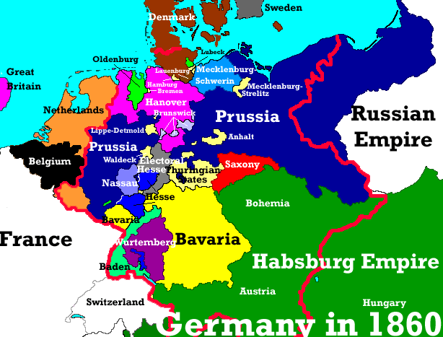
The German Confederacy

Slide 9
The German Confederacy
During Thoreau’s era, Germany was split into 39 separate states, each with its own set of rules, policies, leaders and regulations. This divided country becomes a symbol in “Walden” for Thoreau to draw a parallel to a man who might be dividing his time and efforts and therefore can only truly give a fraction of himself to each effort. Nothing is ever perfected, great potential is watered down, and no great achievements can be achieved.

Slide 10
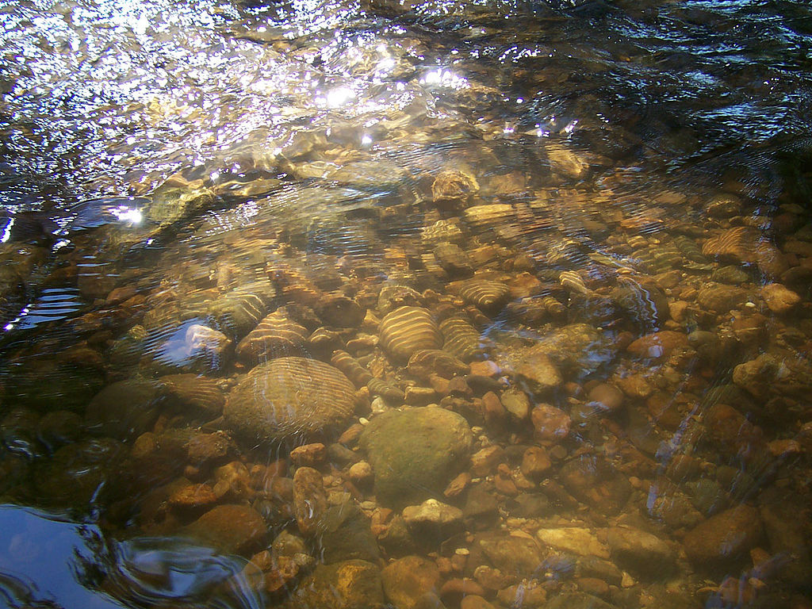
A stream to go a fishin’

Slide 11
A Stream
Thoreau uses the stream to represent man’s greater existence in the universe. One may lead a shallow life and this life is represented by a stream coursing over the pebbles and gravel below which represents eternity. Thoreau puts the duration of our seemingly long lives into perspective and we begin to realize that one must drink deeply and live a life with purpose.

Slide 12
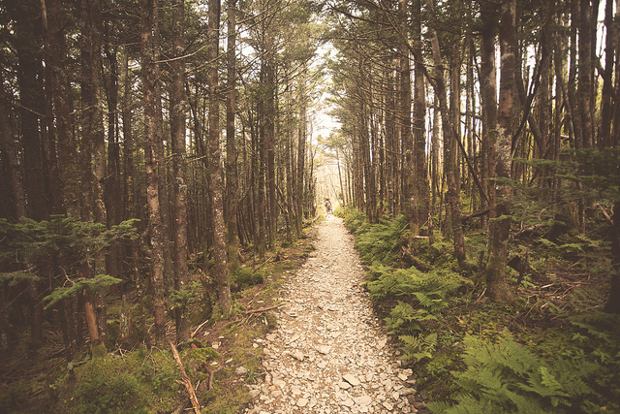
A well worn path

Slide 13
A well worn path
Thoreau states that the earth is impressionable and it does not take long for one to establish a pattern and leave a worn path through repetition. It is easy to fall into routines and one needs to be conscious of established patterns in his life so that he can effect change, a new sense of purpose, and experience new perspectives for growth to occur.

Slide 14
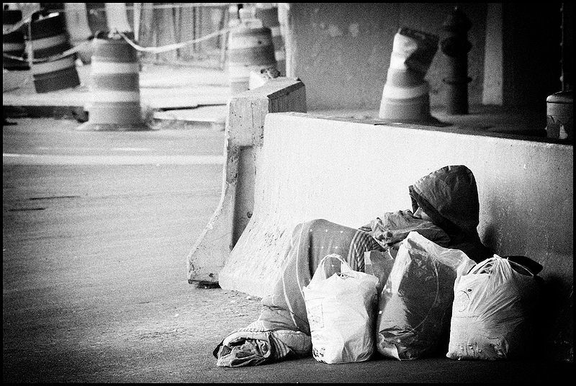
Poverty

Slide 15
Poverty
In discussing poverty, Thoreau suggests that the individual should embrace it and accept his place in the world no matter how “mean” it seems. In relation to the natural world, Thoreau suggests that the rich and the poor are equal as the light of the sun and the beauty of nature are presented to both classes and appear the same. His philosophy prioritizes the spiritual and natural over material excess and he views wealth as a trap that distracts one from a true and pure existence.

Slide 16
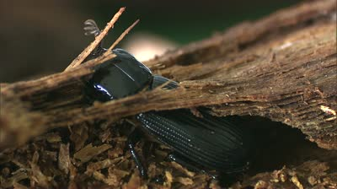
A Beautiful Bug

Slide 17
A Beautiful Bug
In discussing the bug, Thoreau paints a picture of a bug who lies dormant in a tree for many years. This tree is cut down and turned into a table, and after many years of slumber the bug suddenly burrows out from the wood of the table after being brought back to life from the heat of an urn. This image comes to represent rebirth and renewal. Thoreau suggests that life offers second chances. As long as one is willing to dream, the chance of leading a life of purpose survives, no matter how long it may have been buried, dormant, or conceivably dead.

Slide 18
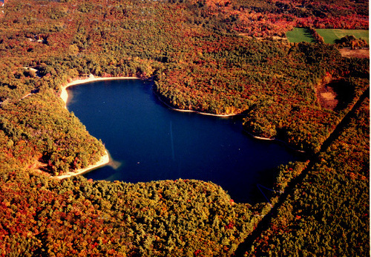
Ariel View

Slide 19
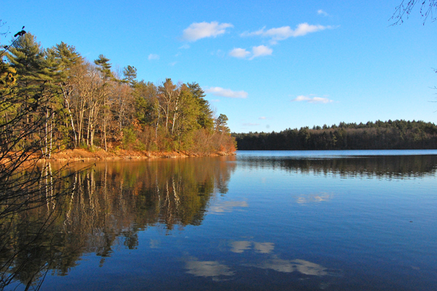
On the shore

Slide 20
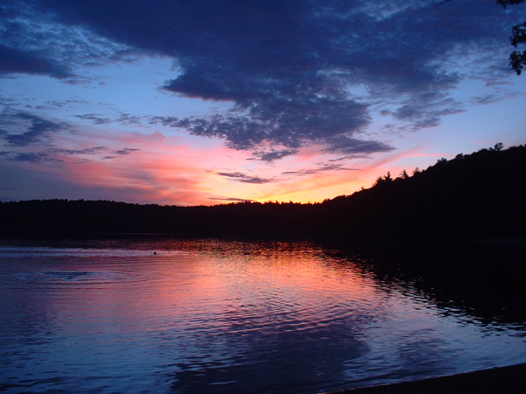
At sunset

Slide 21
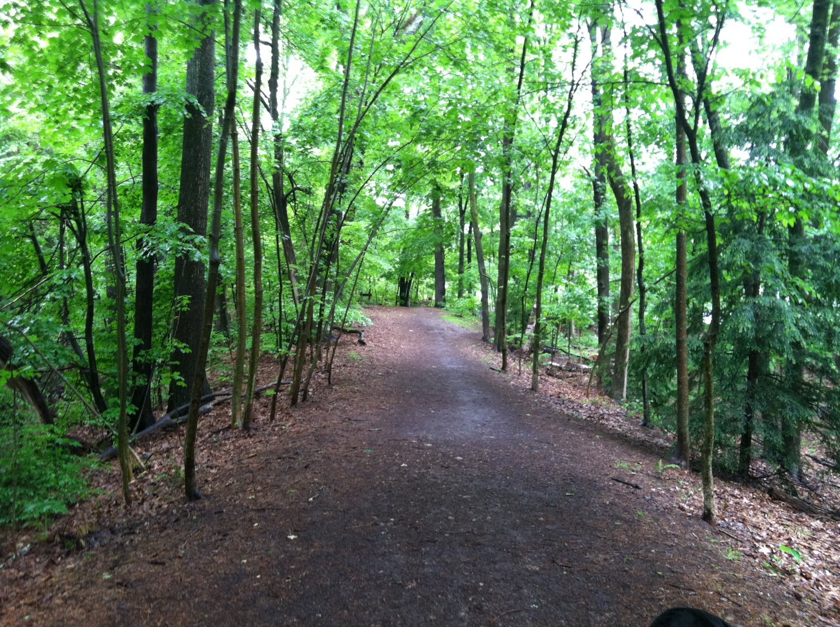
Walking the path

Slide 22
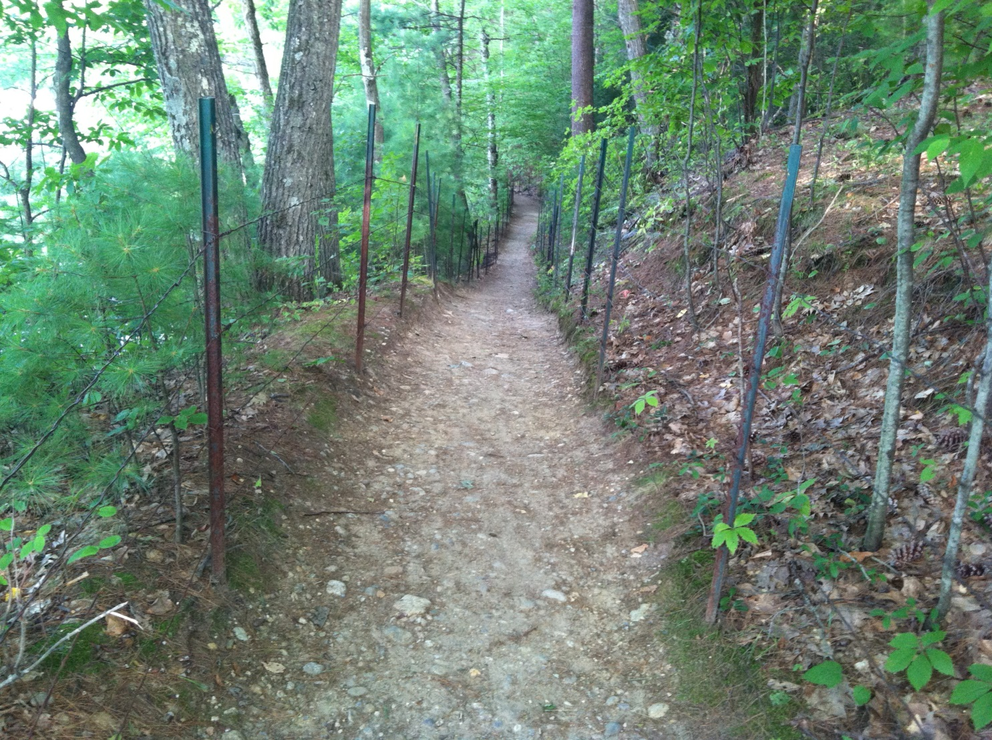
Walking the path

Slide 23
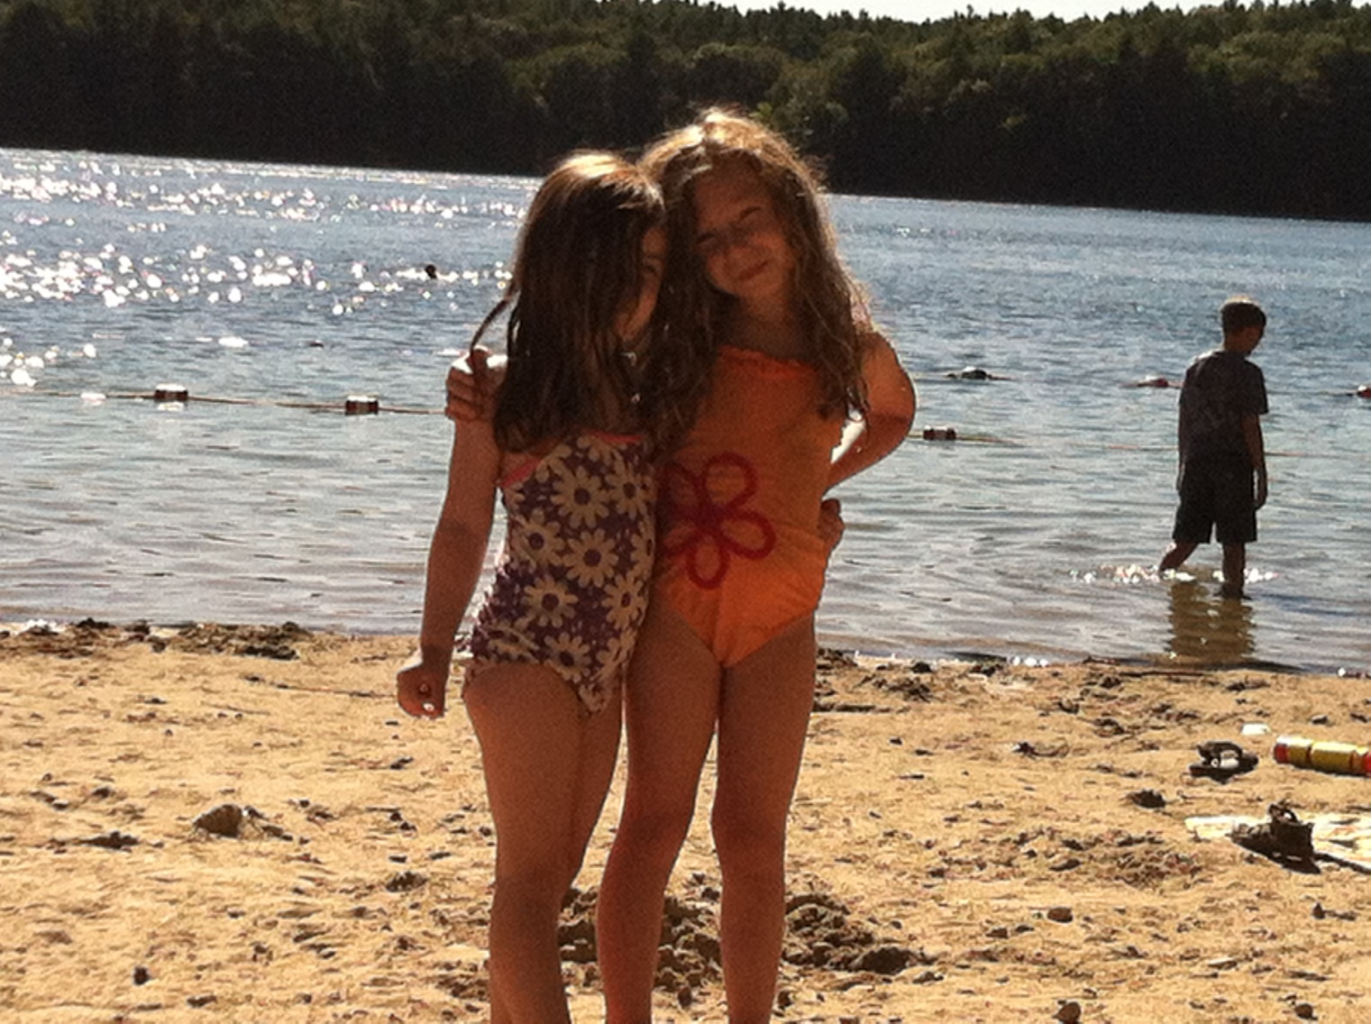
On the beach

Slide 24
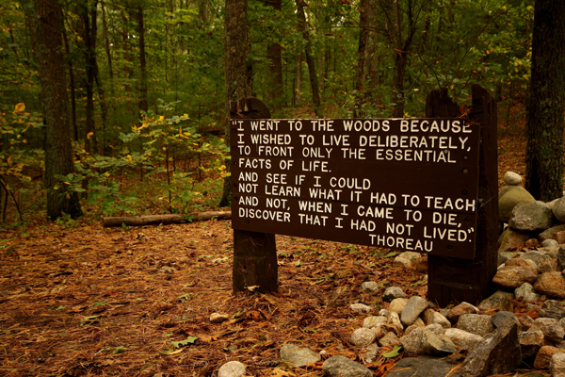
Sign marks Thoreau’s site

Slide 25
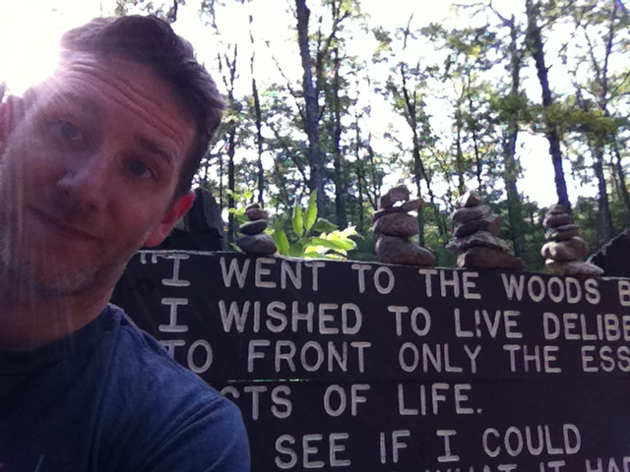
Selfie at Thoreau’s site

Slide 26
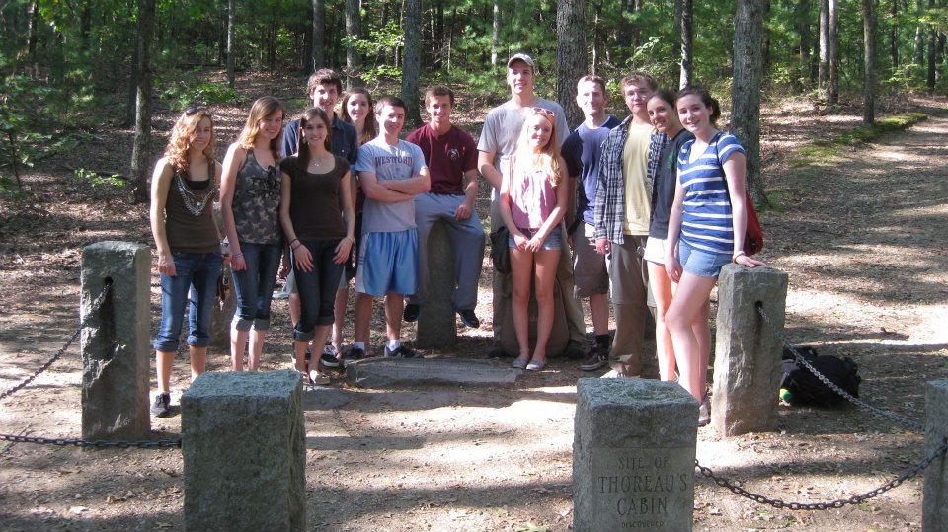
Summer field trip at Thoreau’s site

Slide 27
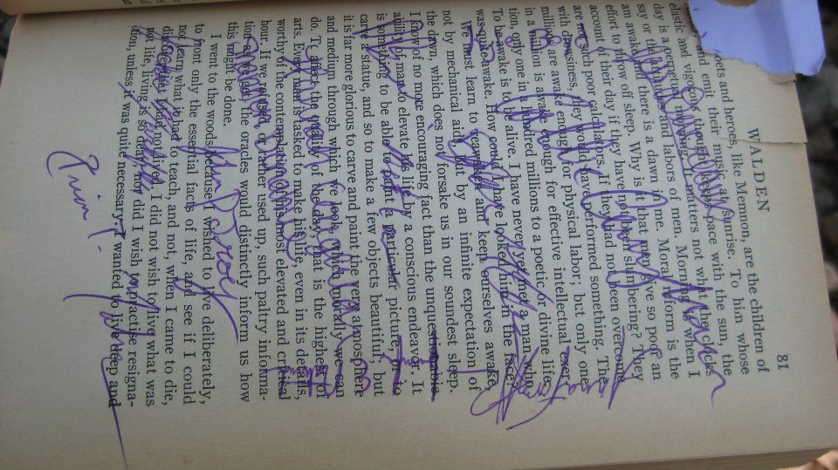
We signed and buried this page.

Slide 28
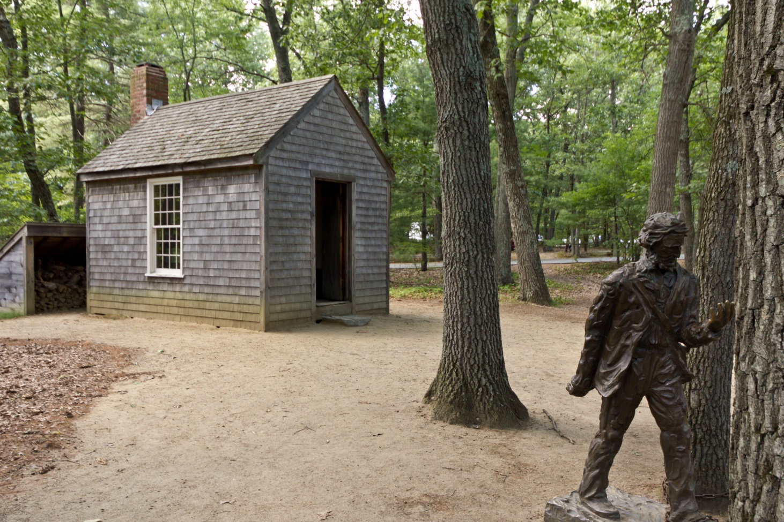
Cabin

Slide 29
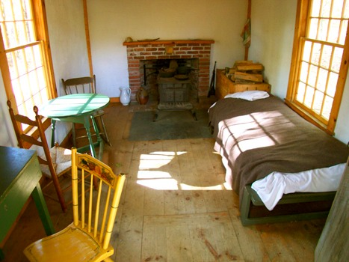
Inside the Cabin

Slide 30
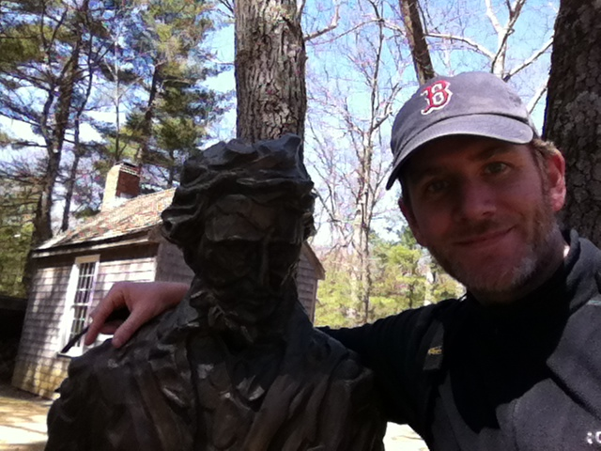
Thoreau’s Statue and Cabin

Slide 31
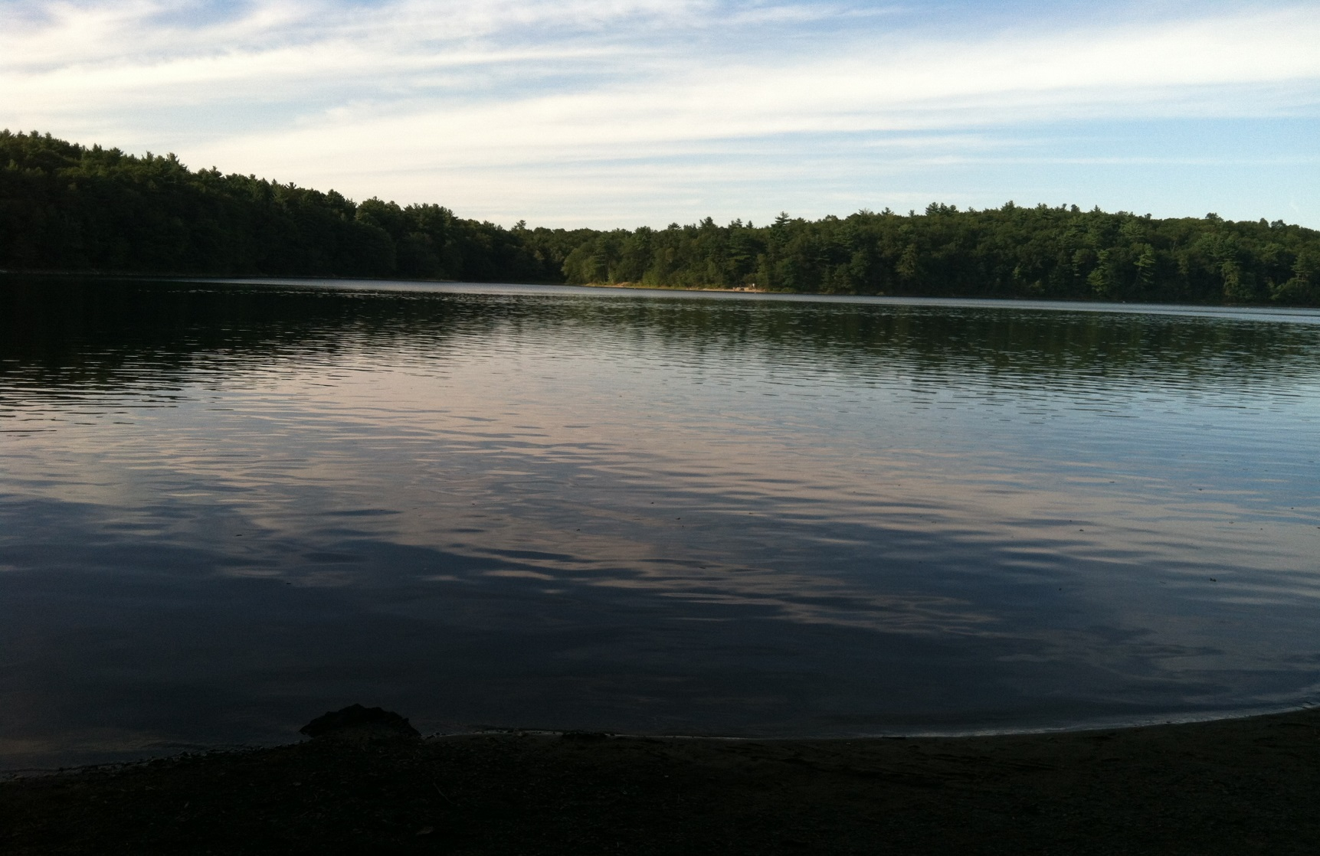
Stillness of the pond at mid-day

Slide 32
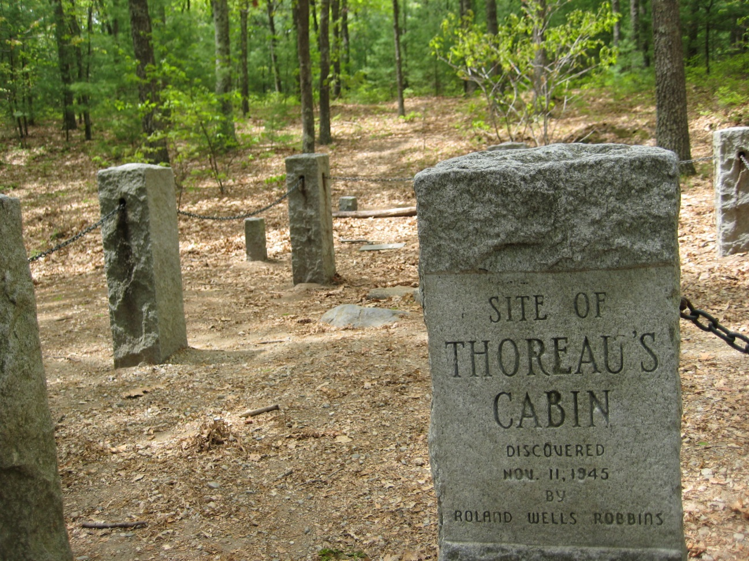
Close up of actual site

Slide 33
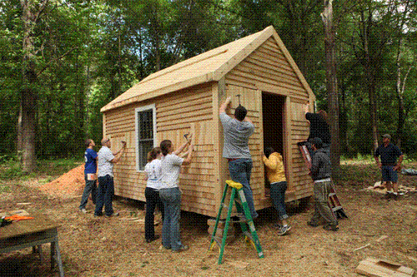
Cabin construction

